Slide 1
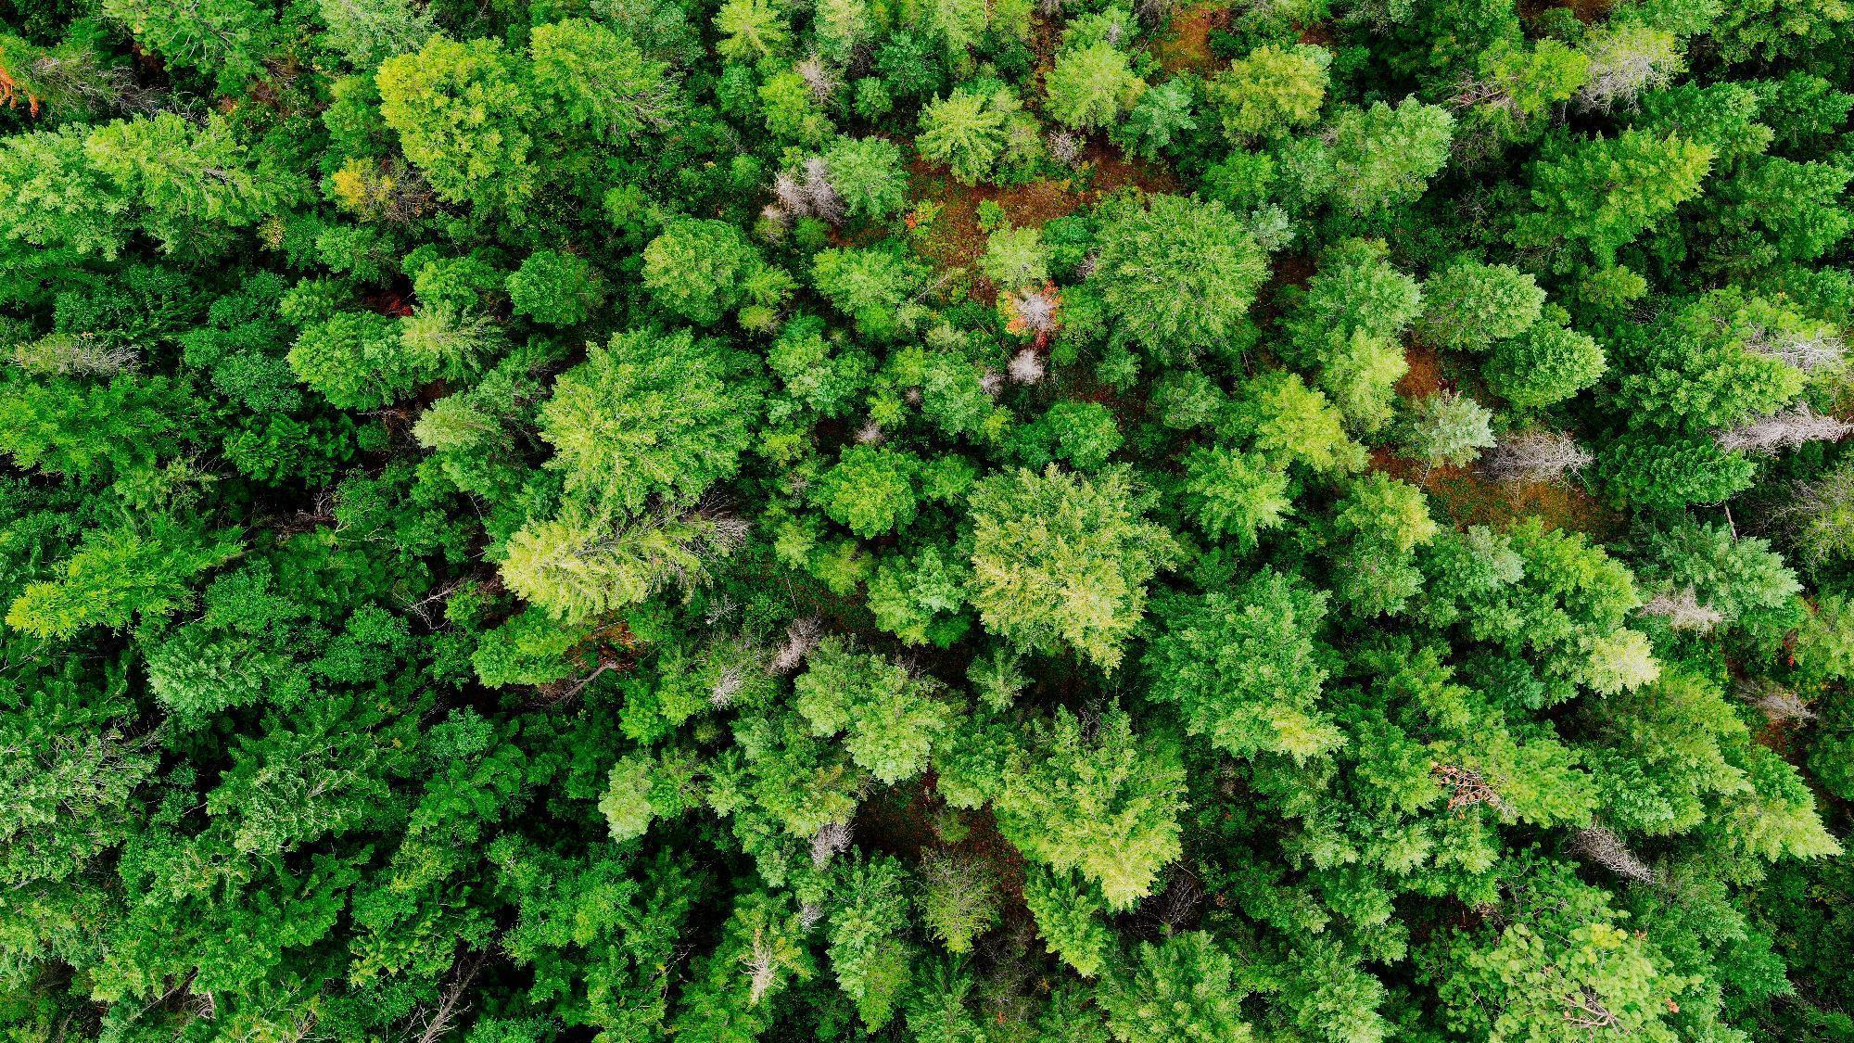
FRI T2 LiDAR Data
Dashboard Overview
Ministry of Natural Resources | Science and Research Branch
Natural Resources Information Section (NRIS)
Forest Resources Inventory (FRI)
Ian Sinclair
Peitao Xu
March 09, 2026

Slide 2


Overview of the T2 inventory process
Checkpoint #1
Checkpoint #2
Checkpoint #3
T2 ABA inventory
Segmentation analysis
Age
review
FIM T2 validation
PCI
OPI
Standardized approach
Tool to combine layers
  Disturbance analysis
Species
review
T1 FIM validation
  Industry/FRI
  FII poly
  Update
T1/T2 Height review
PI
review
Draft T2 inventory
SFL Checkpoints
Pre-inventory
intake discussion
LiDAR/remote sensing modelling
validation results
Draft inventory review
SFL: Sustainable Forest Licensee
FIM: Forest Information Management
PCI: Planning Composite Inventory
OPI: Operational Planning Inventory
FII: Forest Input Inventory
ABA: Area-Based Approach

Slide 3
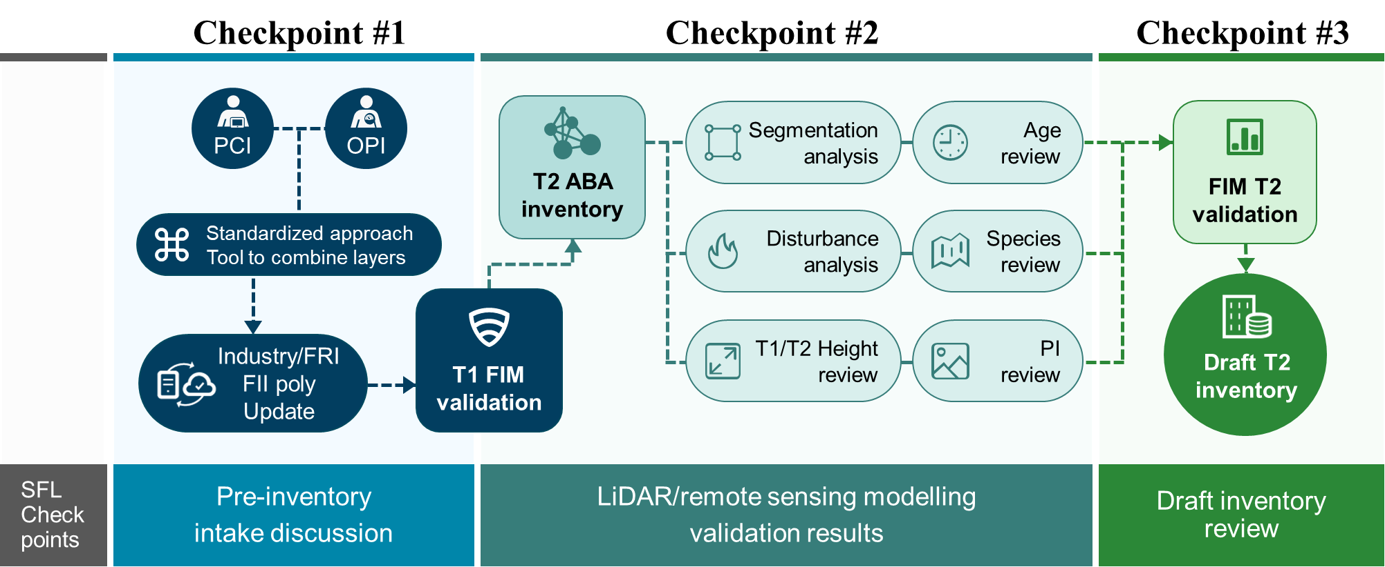



Version control using Tableau Public -
Tableau Dashboard
Draft version 1.0 (Hidden)
Used to communicate with SFL collaborators to identify uncommon values or potential issues in the Term 2 inventory data
Draft version 1.xxx
Few iterations between V1.0 and V2.0
Draft version 2.0 (Hidden)
Shared with SFL collaborators to review all attributes and LiDAR metrics and compare results across the forest management unit
Final version (Hidden)
Used to deliver the finalized Term 2 interactive visualizations to the SFLs with direct links to the supporting dataset available through the FRI Partner Portal download
* All versions – accessible only by direct link

Slide 4

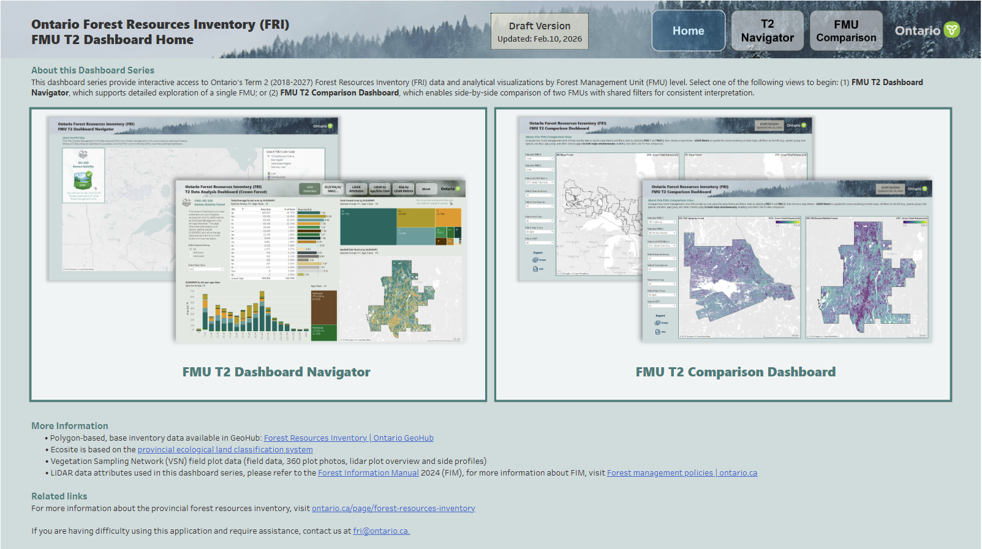
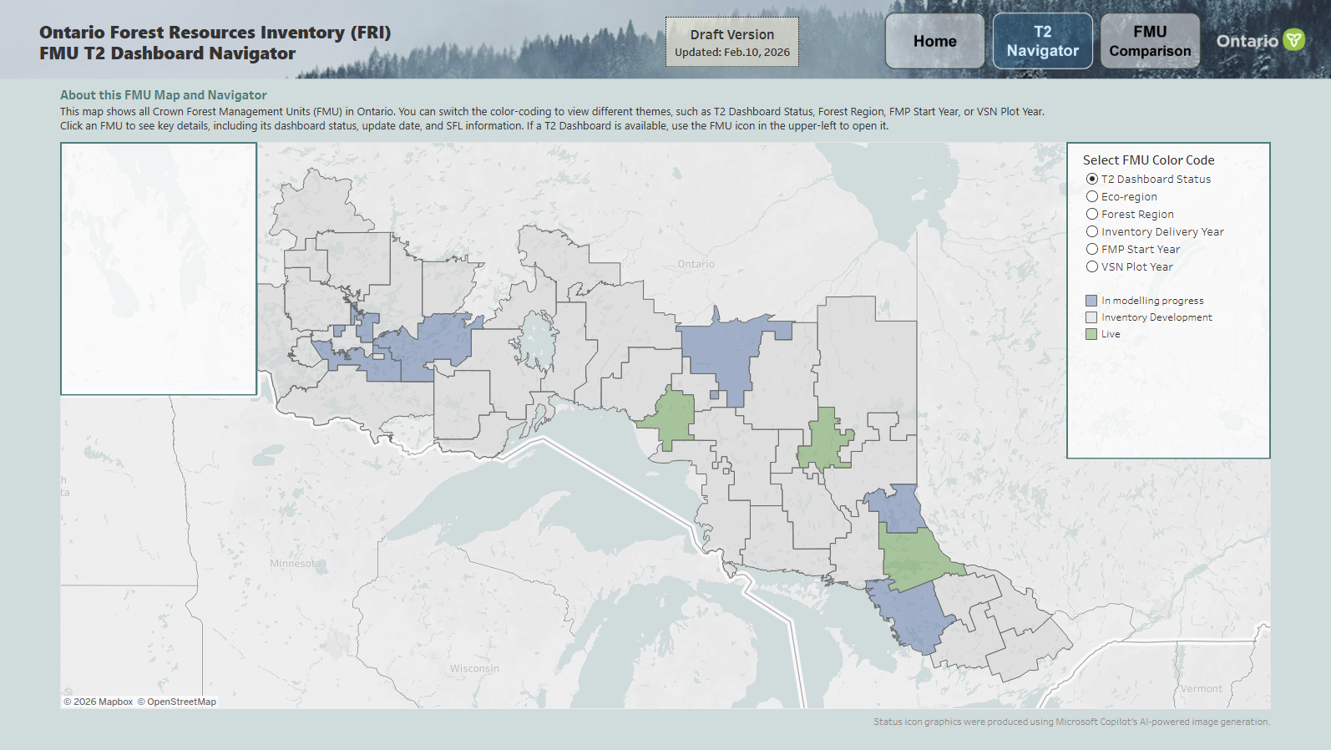
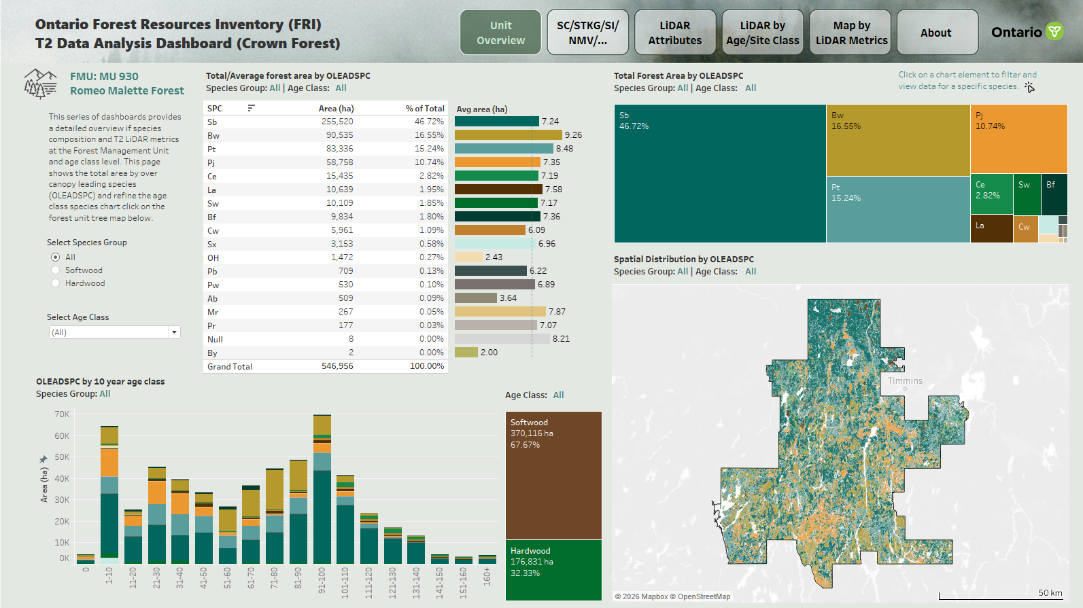
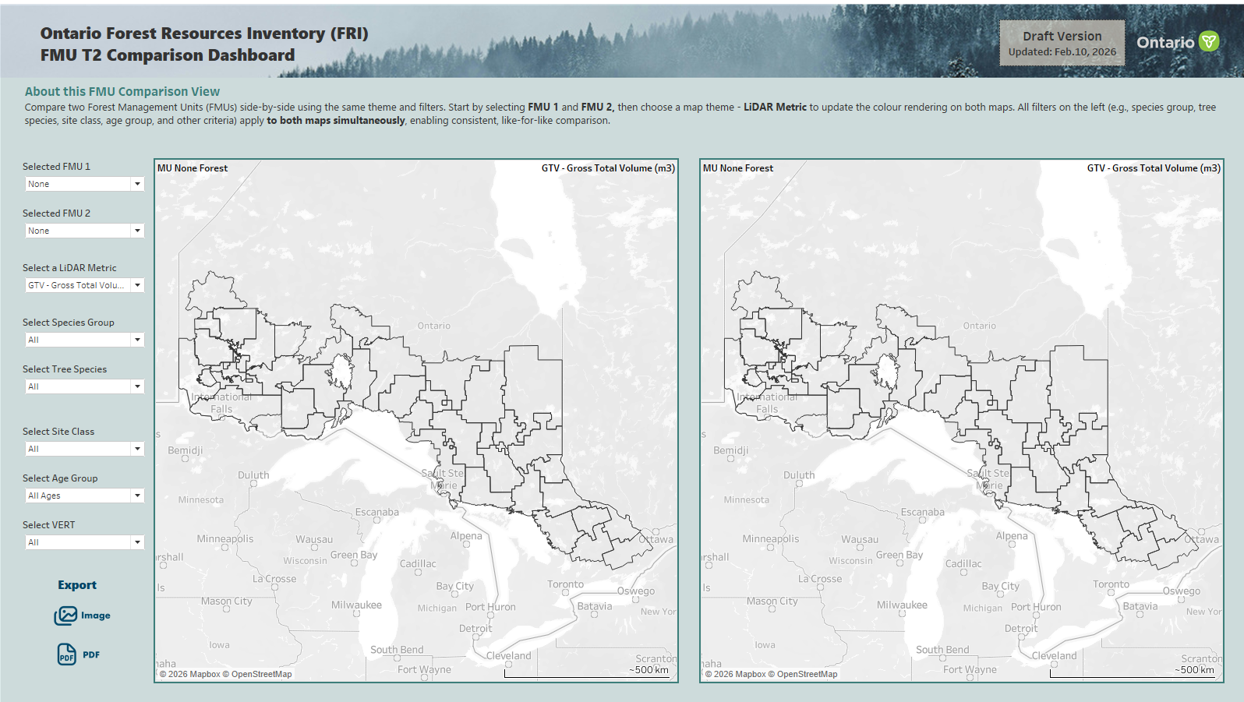
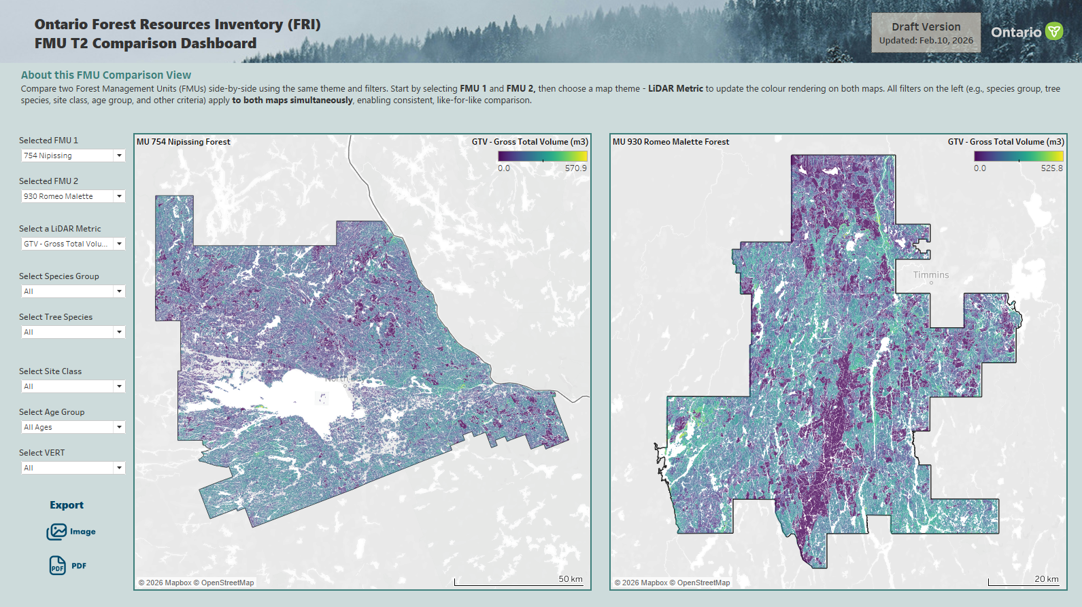
Dashboard overview
Two series of dashboards are planned to be published on Tableau Public as part of the FRI T2 Delivery
0. Home page
1. FMU T2 Dashboard Navigator
1.1 FMU T2 Dashboard
1. The FMU T2 Dashboards offer interactive products for exploring T2 inventory at the target FMU. They present spatial and statistical summaries of key lidar attributes, such as species, height, vertical structure, gross volumes, canopy closure, and others
2. The FMU T2 Comparison dashboard aggregates LiDAR attributes across all published FMUs, enabling SFLs to compare forest conditions between forest units
2. FMU T2 Comparison Dashboard

Slide 5



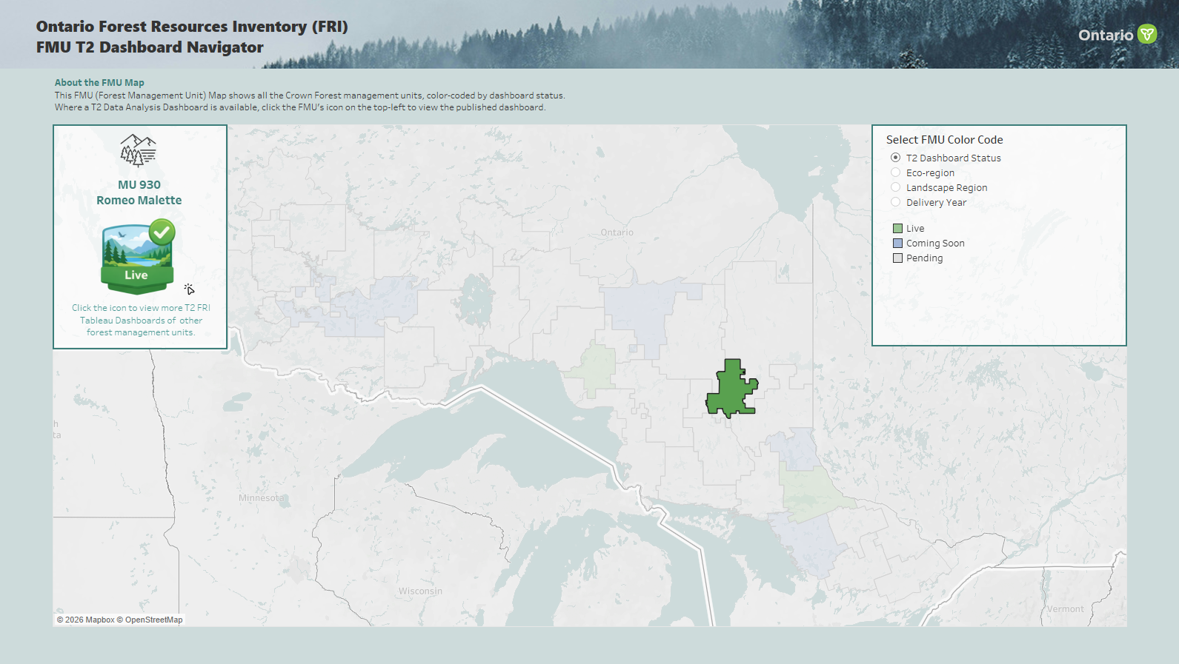
Ontario Forest Resources Inventory (FRI)
FMU T2 Dashboard Home
Home
T2 Navigator
FMU Comparison
Background
About this Dashboard Series
This dashboard series provide interactive access to Ontario’s Term 2 (2018-2027) Forest Resources Inventory (FRI) data and analytical visualizations by Forest Management Unit (FMU) level. Select one of the following views to begin: (1) FMU T2 Dashboard Navigator, which supports detailed exploration of a single FMU; or (2) FMU T2 Comparison Dashboard, which enables side-by-side comparison of two FMUs with shared filters for consistent interpretation.
Text
Table or Chart
Map
Filter
Image
FMU T2 Dashboard Navigator
FMU T2 Comparison Dashboard
More Information
• Polygon-based, base inventory data available in GeoHub: Forest Resources Inventory | Ontario GeoHub
• Ecosite is based on the provincial ecological land classification system
• Vegetation Sampling Network (VSN) field plot data (field data, 360 plot photos, lidar plot overview and side profiles)
• Lidar data attributes used in this dashboard series, please refer to the Forest Information Manual 2024 (FIM), for more information about FIM, visit Forest management policies | ontario.ca
Related links
For more information about the provincial forest resources inventory, visit ontario.ca/page/forest-resources-inventory
If you are having difficulty using this application and require assistance, contact us at fri@ontario.ca.

Slide 6
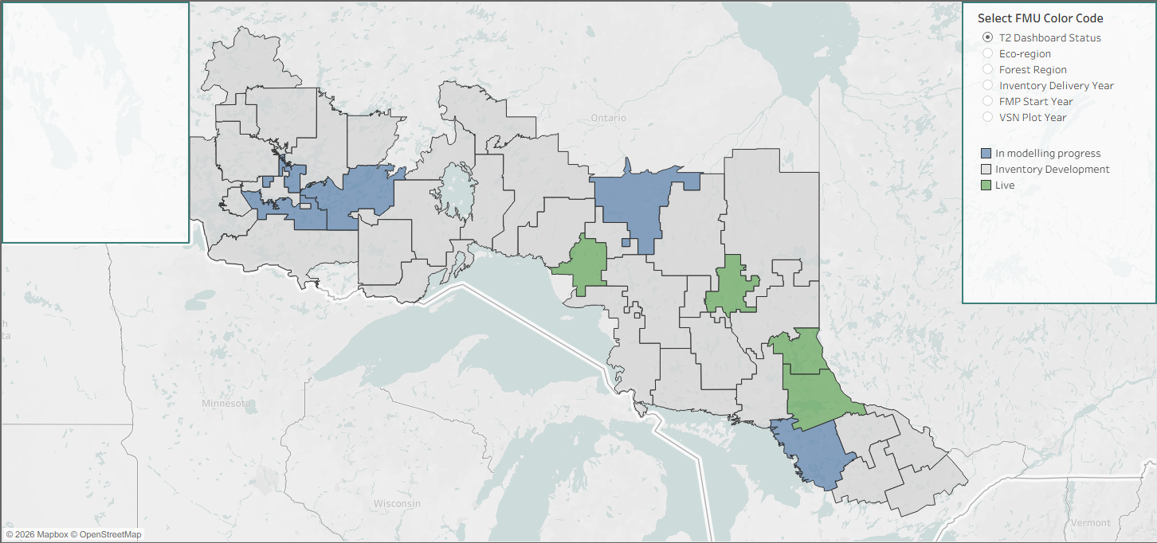

Ontario Forest Resources Inventory (FRI)
FMU T2 Dashboard Navigator
Home
T2 Navigator
FMU Comparison
Background
About this FMU Map and Navigator
This map shows all Crown Forest Management Units (FMU) in Ontario. You can switch the color‑coding to view different themes, such as T2 Dashboard Status, Forest Region, FMP Start Year, or VSN Plot Year.
Click an FMU to see key details, including its dashboard status, update date, and SFL information. If a T2 Dashboard is available, use the FMU icon in the upper‑left to open it.
Text
Click the icon to view the T2 FRI Tableau Public Dashboard of this forest management unit and explore its lidar and spatial data.
This forest’s T2 FRI data is currently in the modelling process, and its dashboard will be released once completed.
This forest’s T2 FRI inventory is still in development. Please check the 'Inventory Delivery Year' option on the right for more information.
Table or Chart
Map
Live
In Modelling Progress
Inventory Development
Filter
Image
Status icon graphics were produced using Microsoft Copilot’s AI‑powered image generation.

Slide 7
Ontario Forest Resources Inventory (FRI)
FMU T2 Comparison Dashboard
Home
T2 Navigator
FMU Comparison
Background
About this FMU Comparison View
Compare two Forest Management Units (FMUs) side-by-side using the same theme and filters. Start by selecting FMU 1 and FMU 2, then choose a map theme - Lidar Metric to update the colour rendering on both maps. All filters on the left (e.g., species group, tree species, site class, age group, and other criteria) apply to both maps simultaneously, enabling consistent, like-for-like comparison. For alternate formats, reach out to fri@ontario.ca.
Text
Selected FMU 1
FMU 1 Map
FMU 2 Map
Table or Chart
Selected FMU 2
Map
Select a Lidar Metrics
Filters
Filter
Image
Export

Slide 8


Ontario Forest Resources Inventory (FRI)
T2 Data Analysis Dashboard (Crown Forest)
Unit Overview
Stand Metrics
LiDAR
Attributes
LiDAR by
Age/Site Class
Map by
LiDAR Metric
About
Background
  FMU: MU 930
  Romeo Malette Forest
Total/Average forest area by OLEADSPC
Table
Single-click on a chart element to filter and view data for a specific species. Double-click to remove the filter and restore the full view.
Weighted
FOR Area by species
Text
This series of dashboards provides a detailed overview if species composition and T2 lidar metrics at the Forest Management Unit and age class level. This page shows the total area by over canopy leading species (OLEADSPC) and refine the age class species chart click on the forest unit tree map below.
Bar table
Avg FOR Area by species
Table or Chart
Map
Map by over canopy leading species
Filter
Metric Filter
Image
Bar chart
OLEADSPC by age class
Weighted
FOR Area by species group

Slide 9
Ontario Forest Resources Inventory (FRI)
T2 Data Analysis Dashboard (Crown Forest)
Unit Overview
Stand Metrics
LiDAR
Attributes
LiDAR by
Age/Site Class
Map by
LiDAR Metric
About
Background
  FMU: MU 930
  Romeo Malette Forest
Stacked Bar Chart
GTV/QMD/HT/BA Avg
By VERT / Canopy level
Metric Filter
VERT / Canopy level
Text
This page compares average values across different species by age group and site class (SC). The upper‑left section presents average values by vertical stand structure (VERT). These values are derived with the assistance of lidar but do not have an associated raster product. For stands younger than 20 years, the Site Class fields may be populated as Null. See the FIM Manual for detailed definitions.
Table or Chart
Map
Metric Filter
Covercon/Coverhwd/SI/OSTKG/NMV
SC
Age Group
Filter
Image
Bar Chart
Avg by SC
Covercon/Coverhwd/SI/OSTKG/NMV
Bar Chart
Avg by SPC
Covercon/Coverhwd/SI/OSTKG/NMV
Maps
Covercon/Coverhwd/SI/OSTKG/NMV

Slide 10
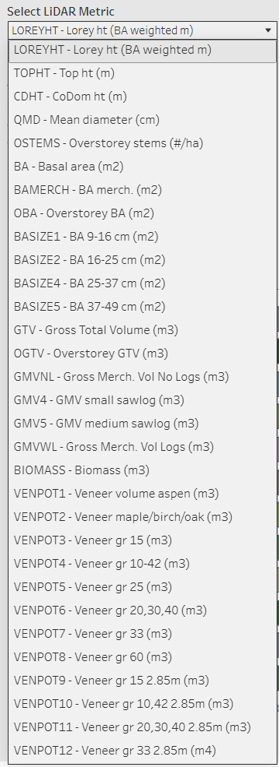
Ontario Forest Resources Inventory (FRI)
T2 Data Analysis Dashboard (Crown Forest)
Unit Overview
Stand Metrics
LiDAR
Attributes
LiDAR by
Age/Site Class
Map by
LiDAR Metric
About
Background
  FMU: MU 930
  Romeo Malette Forest
Mean Stand LiDAR Averages by Species/Bin Size:
Bar Table
Lidar Metric Avg and % of Total
by SPC / Bin Size
Text
All Metrics
This page compares average values (area weighted) selected between species. The bin comparison at right allows you to view each species' distribution. For the description and the bin size of each lidar metric, please see page: ‘About’
Metric Filter
SC
Age Group
Bin Size level
Table or Chart
Map
Filter
Lidar Metric Filter
Image
Mean Stand Lidar Averages by Species：
Bar chart
Lidar Metric Avg by SPC

Slide 11
Ontario Forest Resources Inventory (FRI)
T2 Data Analysis Dashboard (Crown Forest)
Unit Overview
Stand Metrics
LiDAR
Attributes
LiDAR by
Age/Site Class
Map by
LiDAR Metric
About
Background
  FMU: MU 930
  Romeo Malette Forest
Metric Filter
SC
Age Group
Table with Circle
Area and % of Total Area of LiDAR Metric
by 10yr age class / Bin Size
Text
Lidar mean metric values are calculated at the stand level in this page, representing average conditions within each forest stand.
The chart below displays the average of these stand‑level mean values by age class, along with measures of variability such as standard deviation and overall range. The charts on the right group stand‑level lidar metric values into numeric bins, illustrating the distribution of forest area within each age‑class stratum.
Null indicates stands that are not applicable for lidar‑based prediction (e.g., site‑class classification), typically due to leading species age being less than 20 years.
Table or Chart
Map
Filter
Image
Lidar Metric / SPC Filter
Waterfall Chart / Line Chart
Lidar Metric Avg
by 10yr Age Class
Bar Chart
Area of Lidar Metric
by Site Class

Slide 12
Ontario Forest Resources Inventory (FRI)
T2 Data Analysis Dashboard (Crown Forest)
Unit Overview
Stand Metrics
LiDAR
Attributes
LiDAR by
Age/Site Class
Map by
LiDAR Metric
About
Background
  FMU: MU 930
  Romeo Malette Forest
Export
Spatial Distribution Map of Lidar Values
by LiDAR Metrics / Age / SC / VERT / SPC
Text
This page shows the spatial distribution of lidar values. First, select a lidar metric from the leftmost panel. Then, apply filters in the second column (for example, Age Group, Site Class, VERT, and Species Group). The map on the right updates in real time to display the corresponding distribution and legend range. For alternate formats, reach out to fri@ontario.ca
Table or Chart
Map
First Step ↓
Second Step ↓ Select Filters
Select a lidar Metric
SC
VERT
SPC Group
SPC
Age Group
Filter
Image
Reset All Filters

Slide 13
Ontario Forest Resources Inventory (FRI)
T2 Data Analysis Dashboard (Crown Forest)
Unit Overview
Stand Metrics
LiDAR
Attributes
LiDAR by
Age/Site Class
Map by
LiDAR Metric
About
Background
MU 930
Romeo Malette Forest
Key Map
Metadata - About the Lidar Data Attributes
This page lists the available lidar attributes and their descriptions as well as an example of metric bins.
Text
Icon
with link to FMU Navigator
Table or Chart
Map
Click the icon to view more T2 FRI Tableau Dashboards of other forest management units.
Filter
All lidar attributes summarized in this dashboard are listed in the table to the right, along with their corresponding FIM descriptions. The bin size field indicates the value range used to group each metric. The species attribute reference table provides information on tree species codes used for classification, filtering, and display purposes.
Data were updated on 2026‑04‑20 following T2 revisions, for more details, reach out to fri@ontario.ca.
The example below illustrates a forest stand represented by 20 × 20 metre raster cells of Gross Total Volume (GTV). The average GTV across the stand is 226 cubic metres per hectare, with individual cell values ranging from 128 to 465 m³/ha. The chart below summarizes the distribution of these values using 50 m³/ha bins.
Image
Example of Lidar metric distribution - GTV
Metadata - Species Attribute Reference
This table lists all available species codes (SPC), their descriptions, and the associated colour scheme.

Slide 14






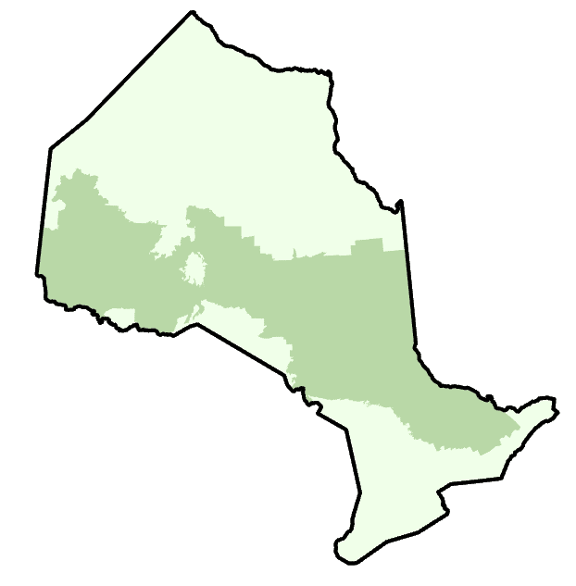
Design Features For Tableau Dashboard
Background Color
Legend
Lidar Metrics Legend
Rounded Corner Bar
Lidar Metrics
Standard Deviation
Overall Range
Mean Average
1cm * 5 cm
VERT
CX
SI
TT
Site Class
0
1
2
3
4
1cm * 3 cm
Icon
1 * 2
1 * 1
Blank
Terminator
1cm * 5 cm
Boreal
GLSL
1cm * 3 cm
Page Navigation
Image
PDF
Reset All Filters
1 * 2
Status icon graphics were produced using Microsoft Copilot’s AI‑powered image generation.
FMU
Navigator
FMU
Navigator
In Modelling Progress
Inventory Development
Live
Ref: Vector Icons and Stickers - PNG, SVG, EPS, PSD and CSS

Slide 15
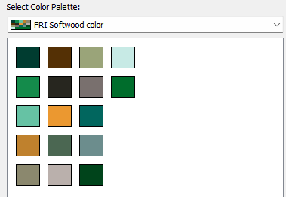
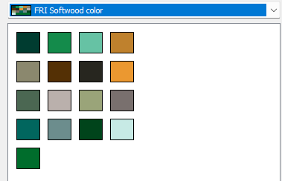
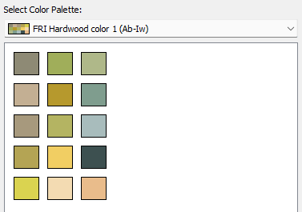
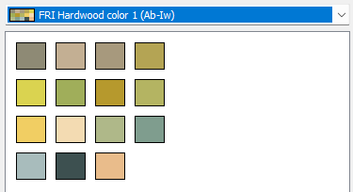
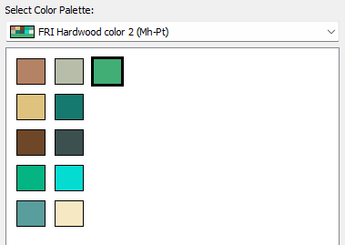
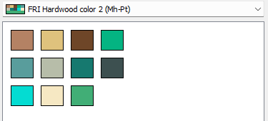
Color Codes For Species
Bf Sx Cr Cw
He La OC Pj
Pn Pr Ps Pw
Sb Sr Sw Ce
SP / SN
Excel
Bf
Sx
Cr
Cw
He
La
OC
Pj
Pn
Pr
Ps
Pw
Sb
Sr
Sw
Ce
SP
Tableau
Ab
Aw
AX
Bd
Be
Bn
Bw
By
Cb
CH
Ew
WX
Hi
Hws
Iw
Ab Aw AX Bd
Be Bn Bw By
Cb CH Ew EX
Hi Hws Iw
Mh
Mr
Ms
Ob
OH
Or
Ow
Pb
PI
PO
Pt
Mh Mr Ms Ob
OH Or Ow Pb
PI PO Pt
MW
Ref:
1. Color names, hex codes, color schemes and tools | Canva Colors
2. ColorBrewer: Color Advice for Maps
3. 8573+ Tree Color Palette ideas in 2026 | iColorPalette

